Slide 1
TeX-the Text Editor
Project by:-
Al Masum Fahim (12.02.04.027)
Farhana Yasmin (12.02.04.045)

Slide 2
Course Info: ʘ Course No: 2100 ʘ Software Development II
Moderated by:
Monjura Afrin Rumi Mam
Lecturer,
Ahsanullah University of Science & Technology

Slide 3
Project Description:
# In this project, we have made a notepad for everyone. Where we can write anything like , important documents, memo or any website’s link

Slide 4
What is Notepad?
Notepad is a generic text editor that enables someone to open and read plaintext files. The resulting files typically saved with the .txt extension

Slide 5
FEATURES
EXCELLENT UI
USER-FRIENDLY
Unicode supported

Slide 6
Splash screen
Counts all the words in the text
Line count
The number of lines will be shown.
Word count
It will appear at the start of the app

Slide 7
Spell checker
Checks the spelling
Multi Tab
Open multiple tabs simultaneously
Word wrap
Changeable word wrapping option

Slide 8
Find
Will find any letter word in the text
Formatting
Will format the text according to the user’s choice
Text to speech
Transform sentences to speech

Slide 9
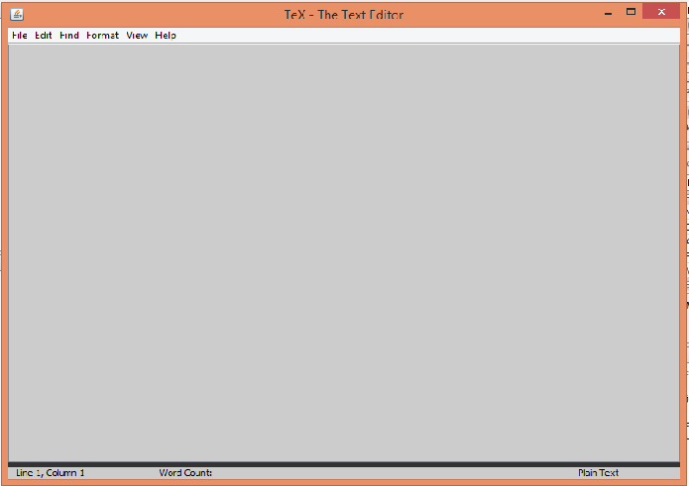

Slide 10
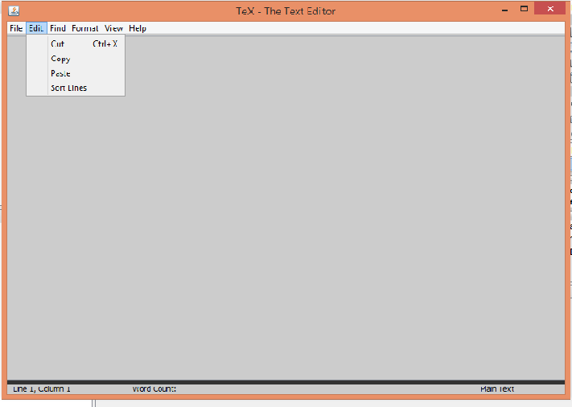

Slide 11
Any questions?

Slide 12
Thank you

